Slide 1
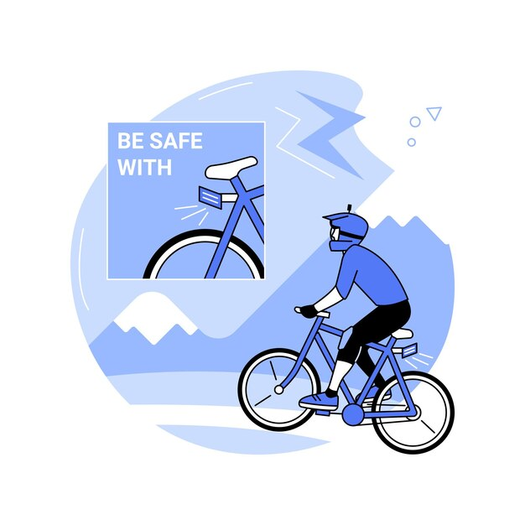
CS3237 Introduction to Internet of Things
CycleSafe

Slide 2


Slide 3
Main features
Blindspot Detection: Detects vehicles in blindspot and alerts the cyclists according to its relative speed and closeness.
Fall Detection: Automatically detects fall and alert surroundings.
Emergency services and close contacts will also be alerted in the case of non-recovery.
Dashcam feature: In the event of a fall, a most recent recorded footage prior to the fall will also be uploaded to the cloud for recording purposes.
Companion telegram bot: Publishes fall event if a fall is detected, with timestamp, most recent recording and cyclist’s current status for providing further assistance.

Slide 4
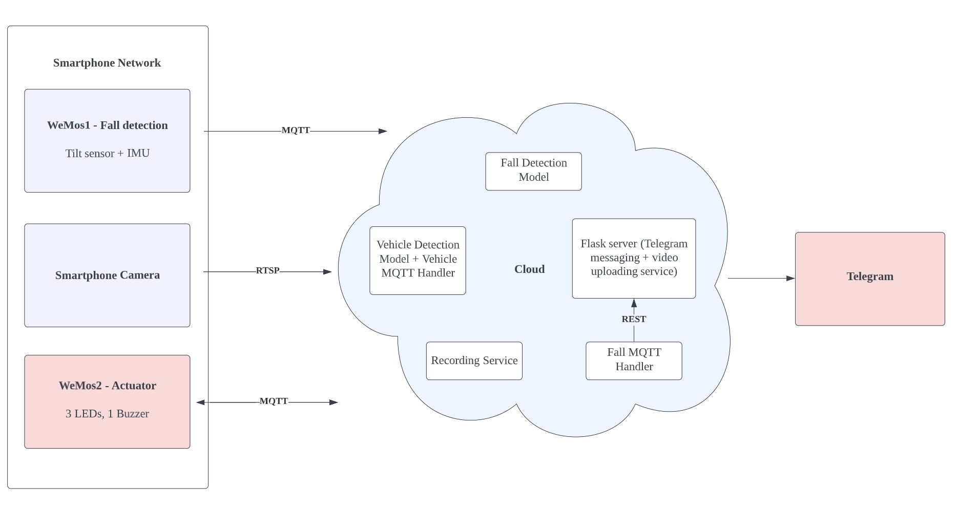
Things

Slide 5
Overall Flow
Sensor Readings
(IMU, tilt switch)
Camera Video Input
Fall Prediction Model
Vehicle Detection Model
Fall Detection Handler
Buzzer, Button
Actuator (LEDs)
(Approaching, Near, Danger)
Telegram Server

Slide 6
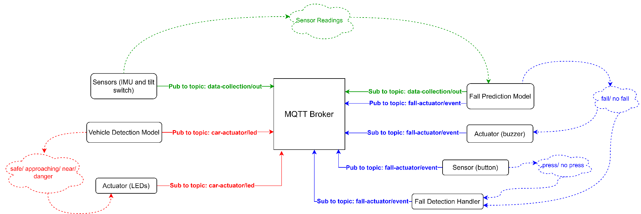
MQTT

Slide 7
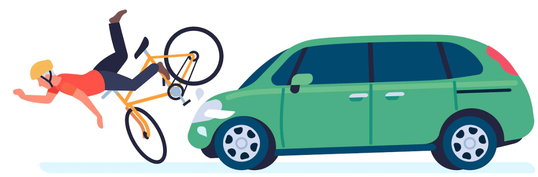
Fall
Detection

Slide 8
Fall Detection Development
Data Collection
Model Training
Model Testing
Real World Testing

Slide 9
Data Collection
Raw features:
acceleration magnitude in the 3 axes
resultant acceleration
gyroscope value in the 3 axes
(left and right) tilt values
Interest: 8 events upright, forward, turning left, turning right, placing down, lying, lifting back up, falling
Collection:
forward -> turning -> forward -> turning -> …
forward -> falling -> lying -> lifting back up -> upright (and repeat it for 100 times)
upright -> placing down -> lying -> lifting back up -> upright -> …

Slide 10
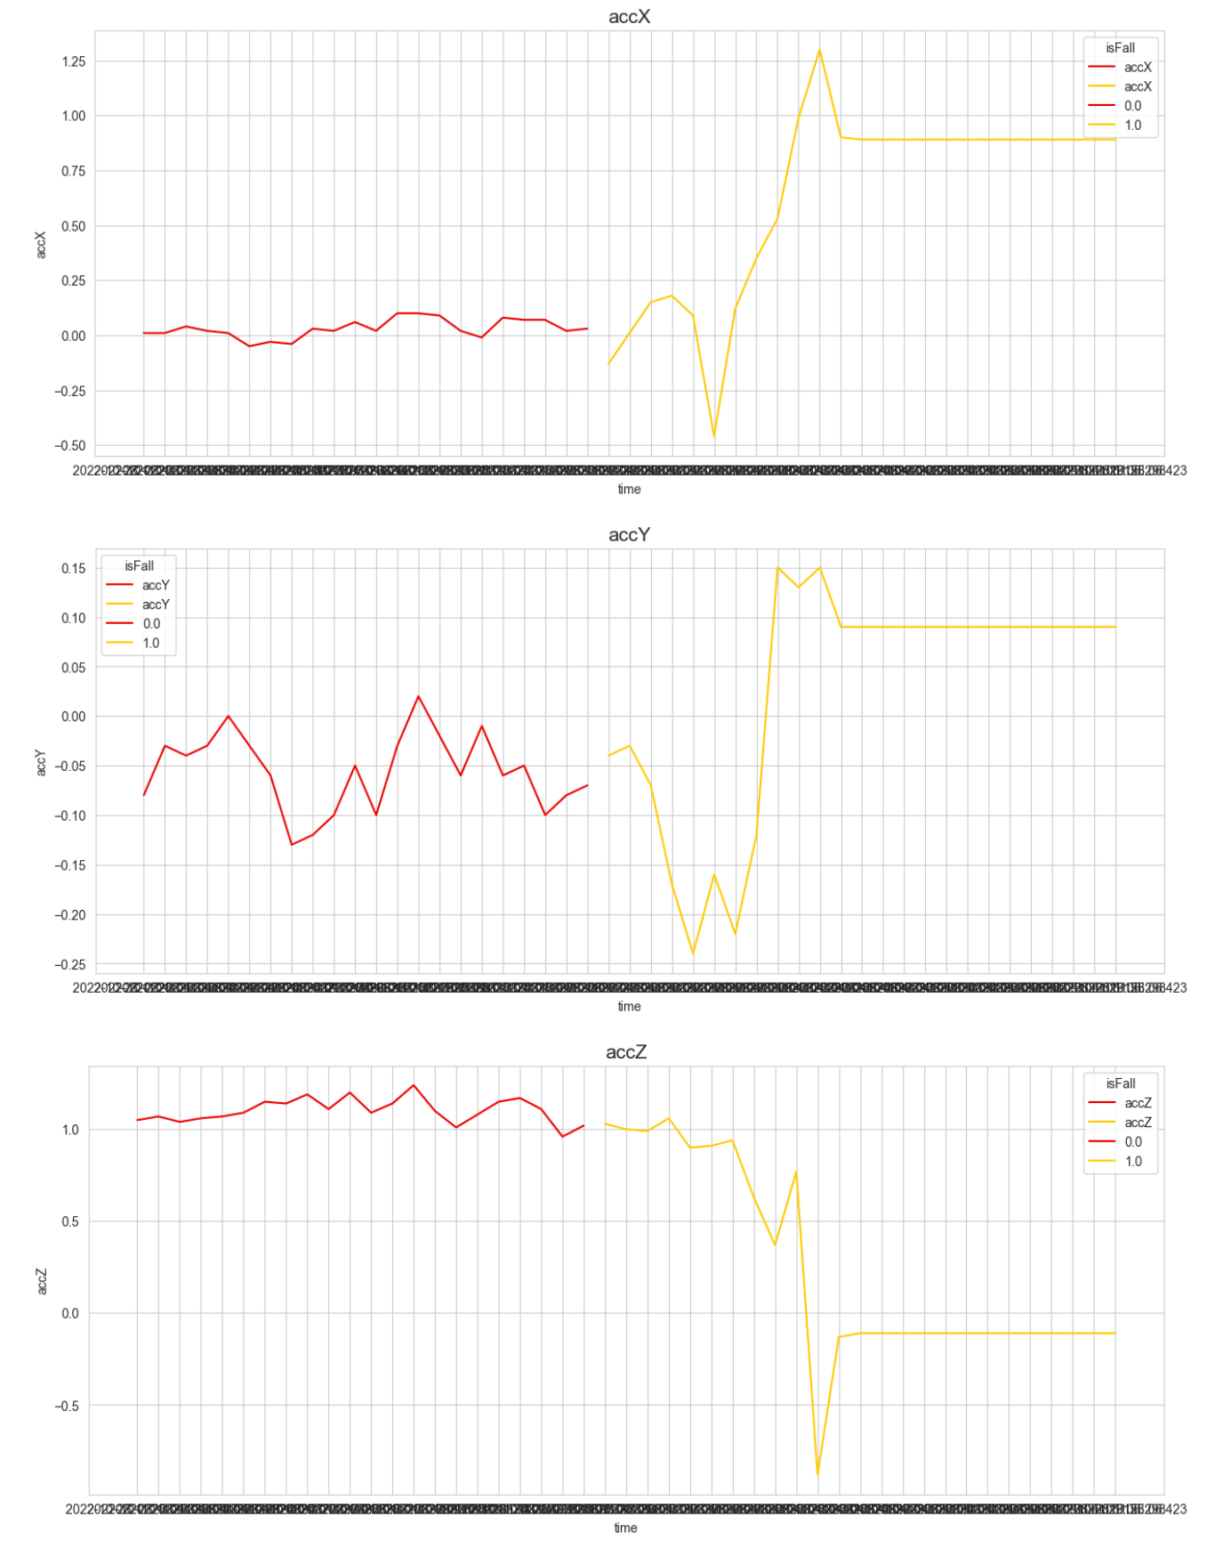
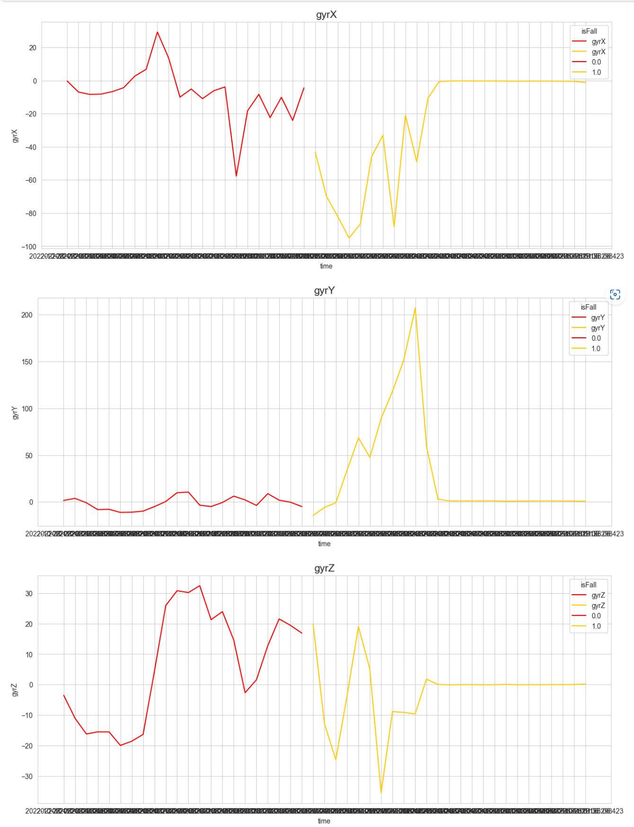
Model Training
Data Processing and Cleaning
For labelling
Discovered that sensors are not working during some iterations
Data Analysis

Slide 11
Model Training
Feature Extraction
Maximum peak to peak acceleration amplitude
Sum vector magnitude
Angle between z-axis and vertical
Orientation change in horizontal plane
…
Models
MLP
LSTM

Slide 12
Model Training Methods
LSTM:
Combine data from 10 samples into a single row
Feed to LSTM with a lookback of 10
Add fully connected layer to predict event
MLP:
Combine data from 10 samples into a single row
Feed to MLP with two hidden layers
1 | 2 | 3 | …… | 10
1 | 2 | 3 | …… | 10
Hidden layer
LSTM
Hidden layer
Dense layer
Dense layer
Output
Output

Slide 13
Model Testing
With vs without feature extraction
Accuracy is higher without feature extraction
Comparison of models:
 | LSTM | MLP
Accuracy | 71.0% | 78.1%
Training time | 60s / epoch Several hours for > 100 epochs | 1s / epoch Few minutes for > 100 epochs
Prediction time | ~50ms | ~50ms

Slide 14
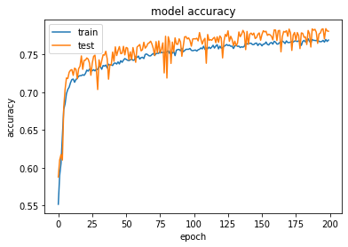
MLP Performance
Chosen model: MLP
MLP model does not underfit/overfit

Slide 15
Real World Testing
Initial Attempt:
Send data to cloud using HTTP
Feed every new data with its previous 9 data points into the model for prediction
Issues
Delay in prediction
Slow model prediction
Communication latency
30s delay in detecting fall after the device is powered on for 1 minute
High Power Consumption
Sending data to the cloud with sampling rate of 10Hz
SOLUTION?

Slide 16
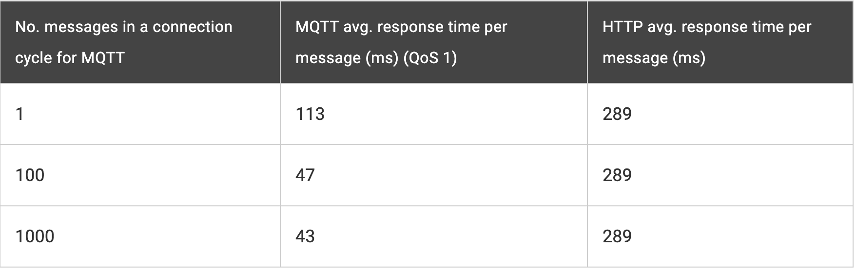
Real World Testing
Replaced HTTP with MQTT
Light weight
Support authentication and data security mechanism like TLS encryption

Slide 17
1.3 g
g = gravitational acceleration

Slide 18
Real World Testing
Send the data to the cloud when the resultant acceleration > 1.3 g
Acceleration is usually ~ 1.5g during falls
Reduce delay by reducing the number of model predictions
Reduce power consumption of the Wemos
Result
Delay is less than 5 seconds
Faster response time

Slide 19
Vehicle Detection

Slide 20
Obtaining Video Stream
RSTP is used to obtain a video stream from the camera. We use the app IP Camera.
Initially in our main program, there is a while loop, we first obtain the frame, and do some processing to detect the vehicles and repeat for each frame we obtained.
Issues faced
Reading frames from the camera is a heavy I/O operation. The function we used cv2.VideoCapture().read() is a blocking operation.
Solution
Multithreading is used to obtain frames in parallel with the processing of the frame. Significantly reduced the lag we had previously encountered.

Slide 21
Vehicle Detection Model
At first, we tried using the Haar feature-based cascade classifiers
It is fast, but lacks accuracy. We needed a way to detect incoming vehicles fast and accurate.
Solution
Used a pre-trained Tiny - YOLOv3 model
Subsequently pruned and simplified by training on the BIT-vehicle dataset, and excluding some of the unnecessary layers.
After successfully detecting vehicles, we needed an algorithm to alert the cyclist about his safety.

Slide 22
Danger detection algorithm
Detect vehicles and obtain the sizes of the vehicles by the area of the bounding box
For each frame, obtain the maximum size of the bounding boxes (MAX_SIZE)
Then, in each frame, compare the current MAX_SIZE, with the previous frame’s MAX_SIZE
CURR_MAX_SIZE / PREV_MAX_SIZE = ratio
Depending on the threshold, alert the cyclist about the incoming vehicle
Ratio : 1 - 1.09 - safe
Ratio: 1.10 - 1.38 - approaching
Ratio > 1.39 - danger
If the MAX_SIZE is above MAX_SIZE_THRESHOLD, also alert the cyclist, that the vehicle is too near
However, this still has a problem, the detection model detects the whole frame, but our region of interest is only the lane the bicycle is on - we need away to ignore the opposite lane where cars travel in the other way, and other lanes the bicycle is not concerned about.

Slide 23
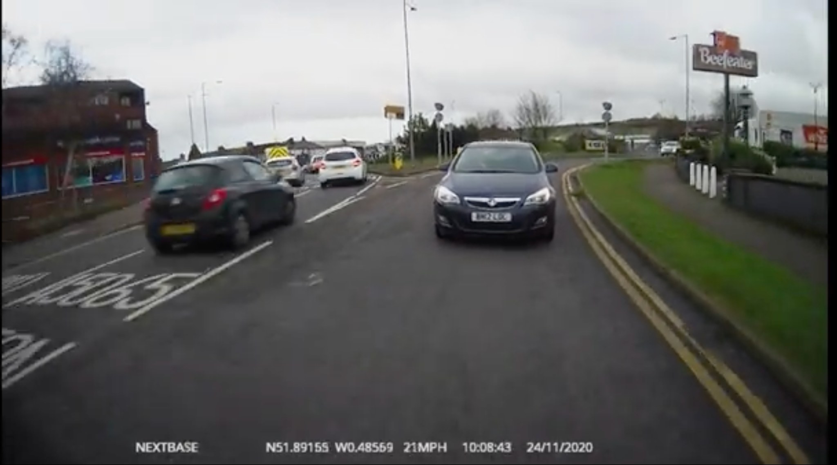
Region of interest
To solve the problem, we limit the region of interest to be in a conical shape, and only care about the cars whose centroid lies within this area.

Slide 24
Power Management
Current implementation:
Reduced data transmissions to the cloud
Possible improvement:
Dynamo
Produce power when wheels are spinning
Power to charge the rechargeable batteries
Reduce the need to manually charge batteries

Slide 25

Security
Add username and password for MQTT Broker
Communication using MQTT - support authentication and data security mechanism like TLS encryption

Slide 26
THANK Y0U

